Slide 1
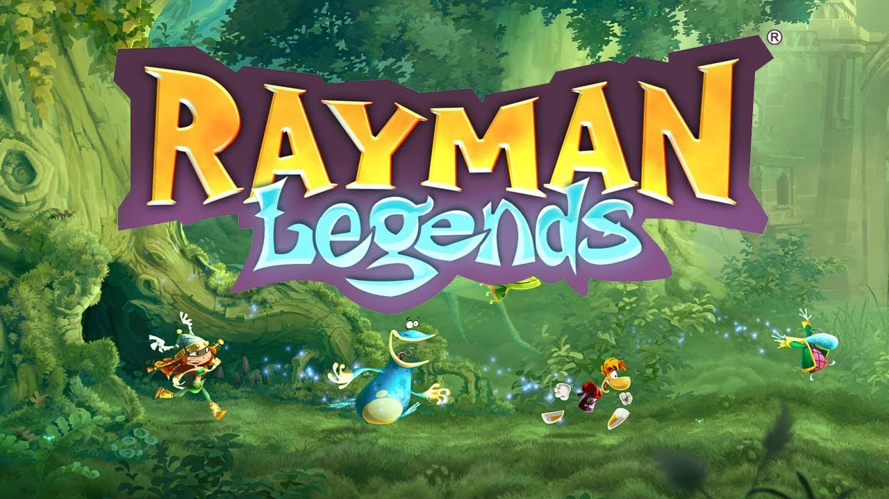

By Adin Holland

Slide 2

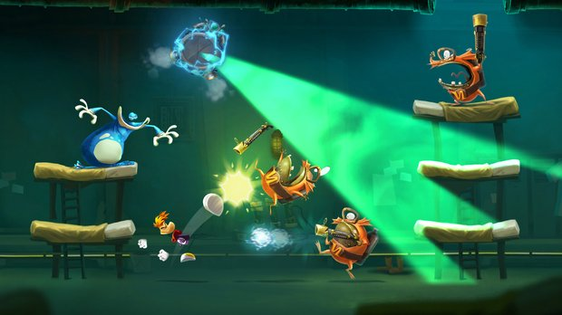
Rayman Legends
Rayman Legends is a 2.5D platformer made by Ubisoft Montpellier and built using the Ubiart Framework engine which was also made by Ubisoft Montpellier.
It is one of the newer games in the long running series of Rayman games.
All of the Rayman games since Rayman: Origins have been built using the Ubiart engine even mobile games.
It was originally released on Xbox 360, PS3, Wii U, PS Vita September 2013
It eventually came to Xbox One and PS4 Febuary 2014
In Rayman Legends specifically there was new 3D gameplay elements included, a new lighting design and a new rendering system.

Slide 3
UbiArt Framework
The UBIart engine was designed specifically for creating games with 2.5d vector graphics without the need for extensive coding.
“The idea was to create an engine with tools powerful enough that we could take a drawing from an artist, render it in an engine, and play it," Xavier Poix, managing director of Ubisoft’s French studios in Montpellier, Annecy and Paris.
This game engine allows a more of an artistic approach to games.
https://www.youtube.com/watch?v=y-chi097uV4

Slide 4

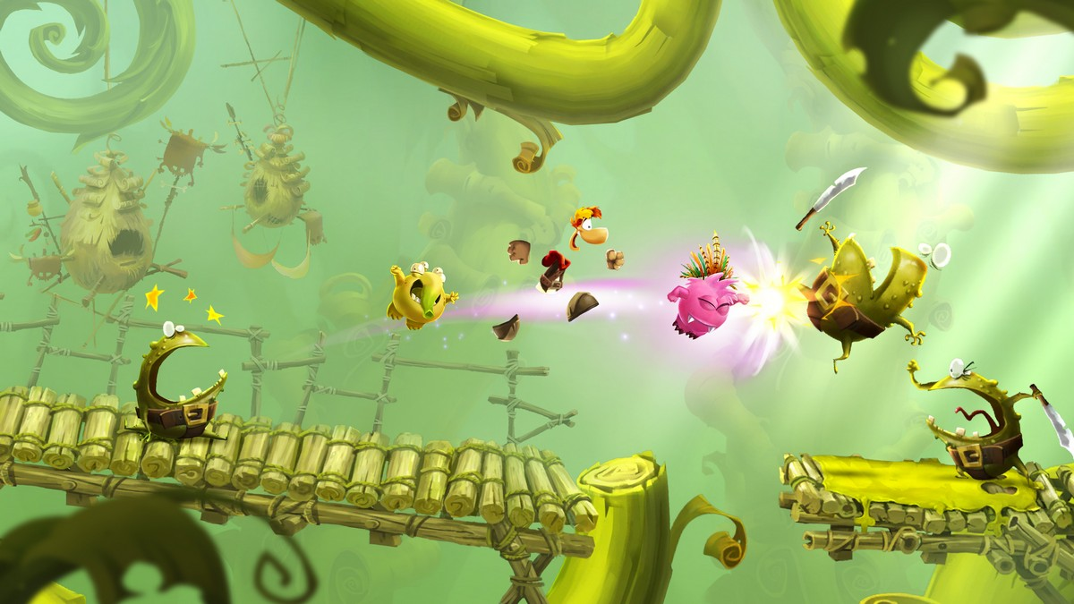


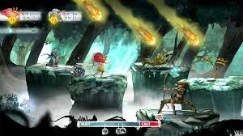
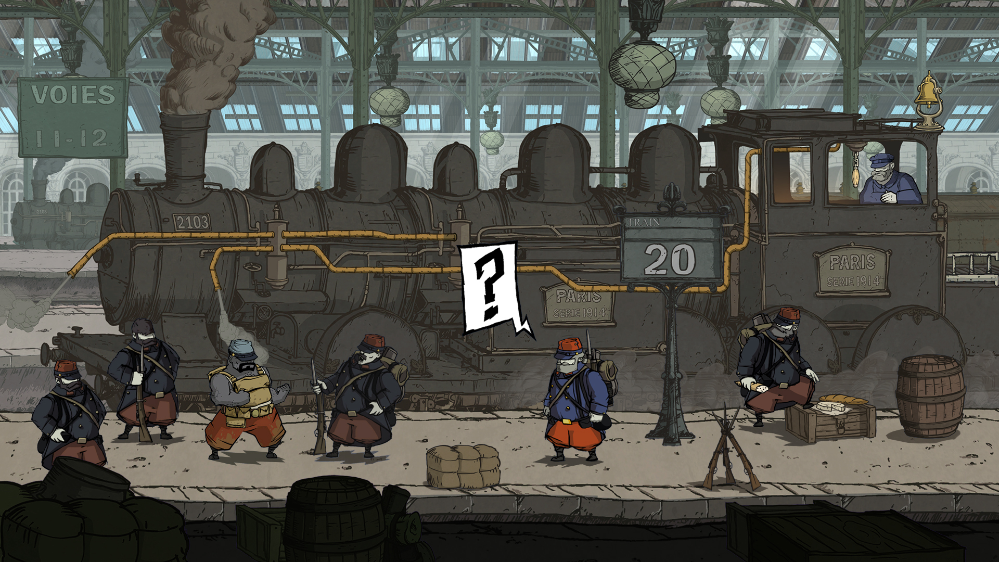
Other Games made using UbiArt Framework
Rayman: Origins
Various Rayman mobile games such as Rayman Jungle run, Rayman Fiesta Run
and Rayman Adventures
Child of light
Valiant hearts
https://www.youtube.com/watch?v=cKH-89teJzQ

Slide 5
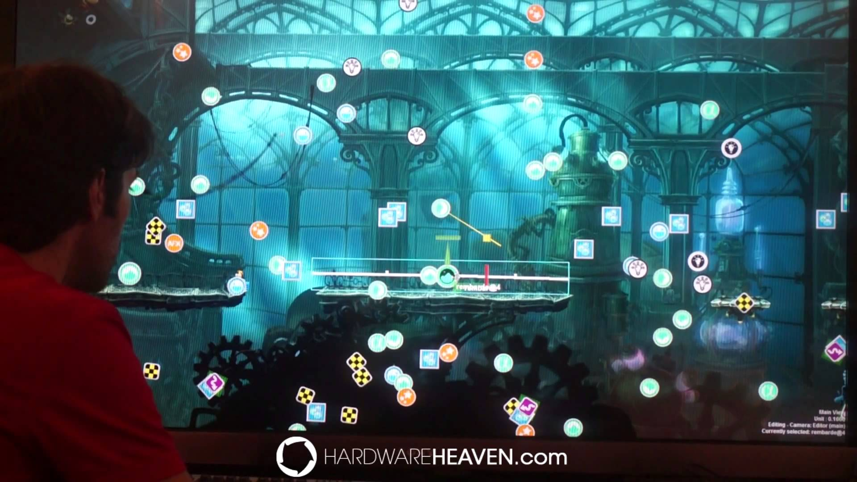
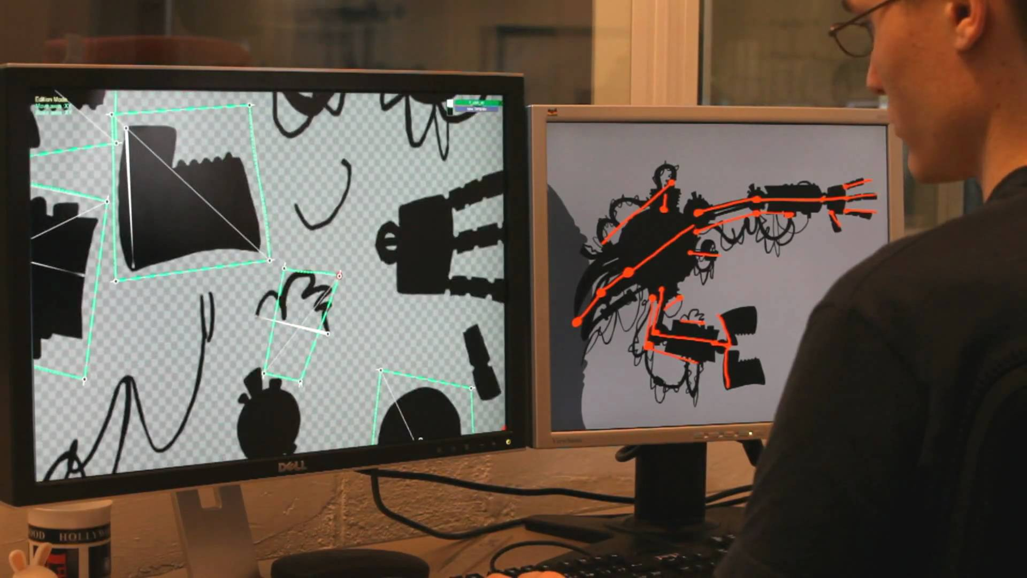
The benefits of the engine
This game engine allows a more of an artistic approach to games.
Editing levels is very intuitive.
The engine also makes it possible to create heavily stylised mobile games, for example Rayman jungle run uses the same assets as its console counterparts.
It also allows a big company to create newer IP’s at a lower risk, they are more likely to experiment.
https://www.youtube.com/watch?v=XoLpPw864eA

Slide 6
References
https://www.ubisoft.com/en-GB/game/rayman-legends/?ref=search
http://www.gamasutra.com/view/news/200015/UbiArt_cultivates_both_creativity_and_culture_at_Ubisoft.php
https://en.wikipedia.org/wiki/Rayman_Legends
https://en.wikipedia.org/wiki/UbiArt_Framework
https://www.gamestm.co.uk/discuss/how-ubiart-framework-is-changing-the-way-games-are-made/
http://www.giantbomb.com/ubiart-framework/3015-5659/

Slide 7
Questions ?

